Slide 5
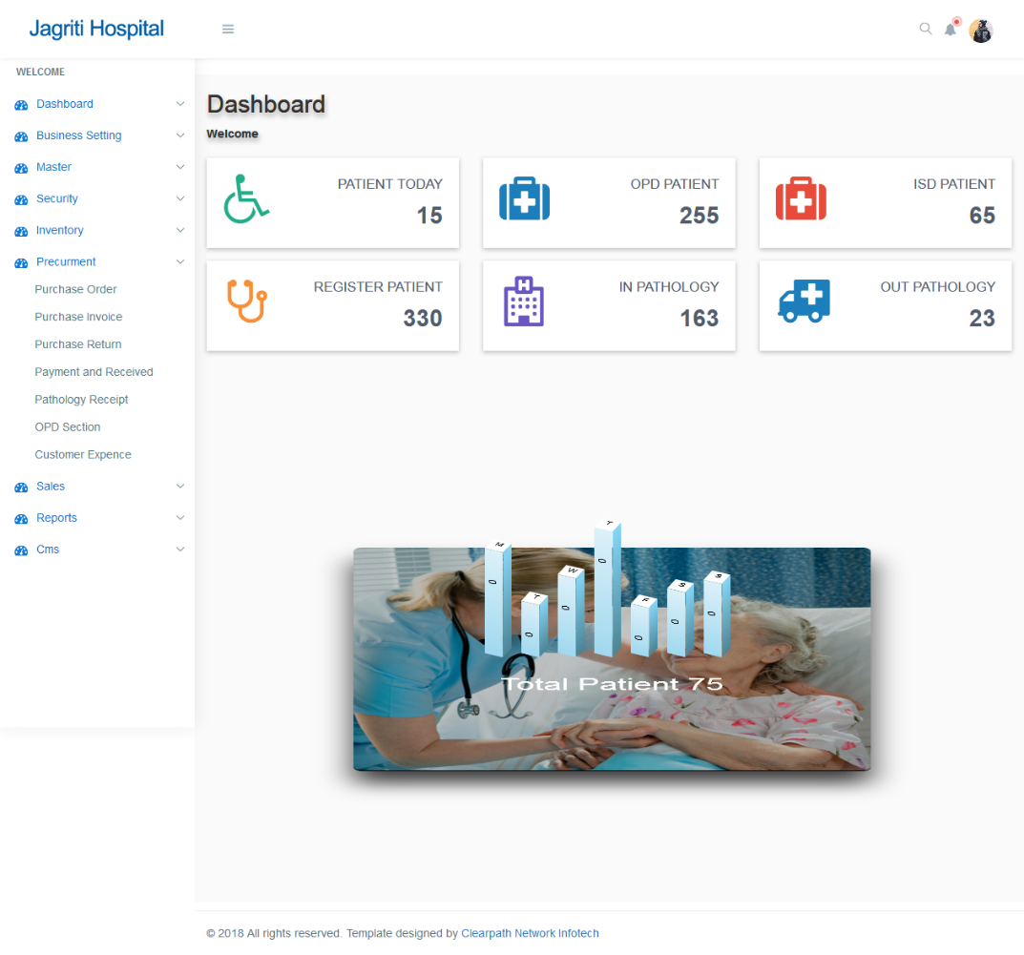
Hospital Management System
Clearpath Network Infotech came up with a Hospital Management that was extremely useful and efficient with following features:
Appointment Scheduling
Front Office Management
Client Profile Management
Inventory Management
Procurement Process
Medicine Sales
OPD Process
Pathology Process
Account Management
MIS Reports
CMS
Sms Integration

Slide 6
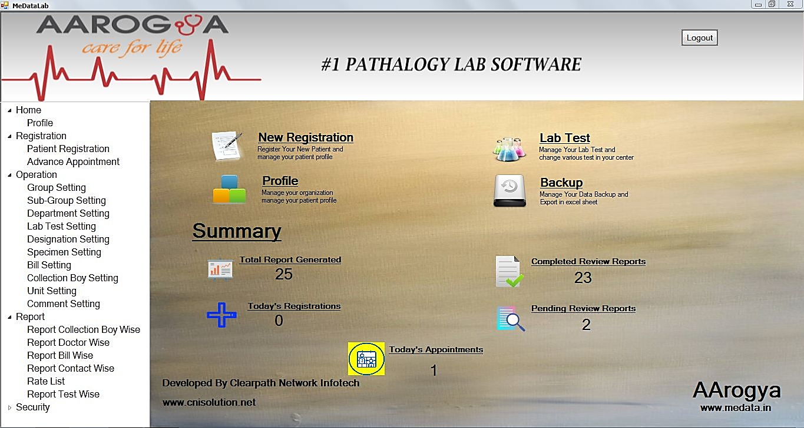
Pathology software
A fully optimized pathology lab software ease in use & understand with multi organization concept with its ability an lab can reduce its current working time on a patient by half and allows the pathology to manage patient and reports of patient with billing section and history of the patients. Allows the user to download the report from web at any point from anywhere

Slide 7
Modules
Benefits of Pathology MS:
Reduced costs and improved efficiency Overall Patients Data Management. Referral Commission Reporting. Easy Information Sharing. Flexible Reporting System. A Centralized Patients record system. Accessible with Doctors & other Staff Members. Flexibility to accommodate new requirements Improved quality and compliance.
Home
Profile
Registration
Registration
Advance Appointment
Report
Report Collection Boy Wise
Report Doctor Wise
Report Contact Wise
Rate List
Report Test Wise
Operations
Group Setting
Sub-Group Setting
Department Setting
Lab Test Setting
Designation Setting
Specimen Setting
Bill Setting
Collection Boy Setting
Unit Setting
Comment Setting
Security
Employee
User and Permission
Database Backup
Password Setting

